Slide 1
Kubernetes Persistent Volume
Index:
Basic Introduction of Kubernetes
What is Persistent volume (PV)
Persistent volume/ Persistent volume claim
When we use AWS EBS
Start by defining a persistent volume configuration file
Create the a persistent volume claim configuration file

Slide 2
Introduction of Kubernetes
Kubernetes is a portable, extensible, open source platform for managing containerized workloads and services, that facilitates both declarative configuration and automation. It has a large, rapidly growing ecosystem. Kubernetes services, support, and tools are widely available.
In organizations, multiple numbers of containers run on multiple hosts at a time. So it becomes very hard to manage all the containers together, a simple solution to this would be Kubernetes. Kubernetes is an open-source platform for managing containerized workloads and services. Kubernetes take care of scaling and failover for our application running on the container.
The name Kubernetes originates from Greek, meaning helmsman or pilot. K8s as an abbreviation results from counting the eight letters between the "K" and the "s".

Slide 3
What is Persistent Volume
Managing storage is a distinct problem from managing compute instances. The PersistentVolume subsystem provides an API for users and administrators that abstracts details of how storage is provided from how it is consumed. To do this, we introduce two new API resources: PersistentVolume and PersistentVolumeClaim.

Slide 4
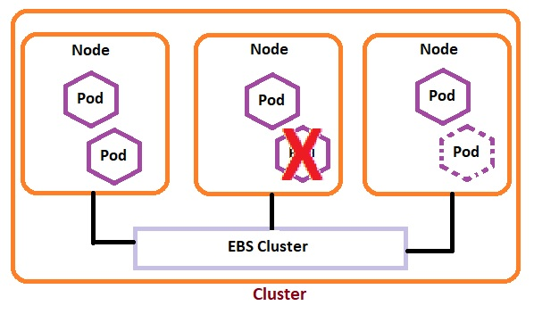

Slide 5
What is Persistent volume (PV)
In a typical IT environment storage is managed by the storage/system administrator The end user will just get instruction to use the storage but does not have to worry about the underlying storage management
In the containerization world we would like to follow similar rule but it become challenging, give the many volume type we have seen earlier Kubernetes resolve this problem with the persistent volume subsystem
Persistent volume is a cluster wide resource that you can use to store data in a way that it present beyond the life time of a pod
The Persistent volume is not backed by locally attached storage on a world node but by a networked storage system such as an EBS or NFS or a Distributed filesystem like Ceph
K8s provide APIs for users and administrator to manage and consume storage to manage that volume it user The Persistent volume API resource type and to consume it uses the persistent volume clam API resource type

Slide 6
Persistent volume/ Persistent volume claim
PersistentVolume: it models shared storage that has been provisioned by the cluster administrator. It is a resource in the cluster just like a node is a cluster resource. Persistent volumes are like standard volumes, but having a lifecycle independent of any individual pod. Also they hide to the users the details of the implementation of the storage, e.g. NFS, iSCSI, or other cloud storage systems.
PersistentVolumeClaim: it is a request for storage by a user. It is similar to a pod. Pods consume node resources and persistent volume claims consume persistent volume objects. As pods can request specific levels of resources like cpu and memory, volume claims claims can request the access modes like read-write or read-only and storage capacity.

Slide 7
When we use AWS EBS
AWS EBS
An AWS EBS volume mount as Aws EBS volume into your pod unlike emptyDir which is erased when a pod is removed the contents of an EBS volume are preserved and the volume is merely unmounted
There are some restriction when we use EBS
The nodes on which pods are running must be aws EC2 instance
Those instance need to be in the same region and ability zone as the EBS volume
EBS only support a single EC2 instance mounting a volume

